Slide 1
PennyTrack: Integrating Expense Tracking with AI-Driven Investment Recommendations
PIP2001 Capstone Project
Review-4
Batch Number: CIT G-11
Under the Supervision of,
Dr. Shanthi S
Assistant Professor
School of Computer Science and Engineering
Presidency University
Roll Number
20211CIT0046
20211CIT0051
20211CIT0088
Student Name
Abdul Aman Khan Rehan Ashraf
Mihir Suman
Name of the Program: B.Tech CSE-IoT
Name of the HoD: Dr. Anandraj SP
Name of the Program Project Coordinator: Dr. Sharmasth Vali Y
Name of the School Project Coordinators: Dr. Sampath A K

Slide 2
Introduction
In today's digital age, where smartphones are ubiquitous, the Expense Tracker project introduces a revolutionary Android-based financial management solution. This application addresses the limitations of traditional expense tracking methods, replacing manual diary entries and error-prone spreadsheets with an automated digital diary system. The project aims to streamline daily and monthly expense monitoring, catering to both individual users and organizations.
The Expense Tracker application begins with a user-friendly registration process, where each user is assigned a unique ID. This personalized approach allows for accurate and individualized financial tracking. Once registered, users input their income, which the app intelligently allocates into daily expense allowances. The system's dynamic nature shines in its ability to adjust these allowances based on actual spending patterns. When users underspend, the excess amount is automatically added to their savings, while overspending triggers a recalculation of future allowances, ensuring consistent budget management.

Slide 3
Introduction
Key features of the Expense Tracker include:
1. Comprehensive analysis of expenses on daily, monthly, and yearly bases
2. Visual representation of financial data through multiple graph formats
3. Customizable report generation in Excel, PDF, and printable formats
4. Advanced data mining capabilities for income and expenditure predictions
5. Integrated savings tracking and management
6. User-defined expense limits and categories
Developed using the Software Development Life Cycle methodology and leveraging IBM Cloud Services, the application ensures a robust, scalable, and user-friendly experience. The interface is designed for intuitive navigation, minimizing the learning curve for new users.

Slide 4
Introduction
For organizations, the Expense Tracker offers systematic budgeting tools and efficient expense handling, crucial for stakeholders in managing organizational expenditures. It simplifies the often, complex task of financial oversight, providing clear insights into spending patterns and potential areas for cost optimization.
By providing real-time insights into spending habits, the Expense Tracker empowers users to make informed financial decisions, prevent budget crises, and maintain long-term financial stability. The application's predictive capabilities assist in future financial planning, while its comprehensive reporting features offer a clear view of one's financial health.
In essence, this project not only simplifies expense management but also promotes financial literacy and responsible spending habits in our increasingly digital world. By harnessing the power of mobile technology, the Expense Tracker transforms the challenge of personal finance management into an accessible, efficient, and even engaging daily practice.

Slide 5
Literature Review
[1] A. Manchanda, Expense Tracker Mobile Application, IEEE, 2012. This expense tracker application is designed to empower users to efficiently monitor and manage their daily financial activities. Beyond basic tracking, it emphasizes identifying and reducing unnecessary expenditures, encouraging users to adopt disciplined spending habits.
[2] G. Bekaroo and S. Sunhaloo, Intelligent Online Budget Tracker, IEEE, 16 June 2014. The Intelligent Online Budget Tracker introduces a comprehensive solution for financial planning through online platforms. Its cloud-based system allows users to access their budget data from multiple devices securely, ensuring convenience and data consistency.
[3] N. Jagtap, P. Joshi, and A. Kamble, A Review on Budget Estimator Android Application, IEEE, April 2019. This budget estimator application advances expense management by incorporating location-based services. It leverages Google APIs to provide users with contextual notifications about nearby shopping deals, enhancing their decision-making process. The app also integrates budget forecasting tools and spending alerts, enabling users to anticipate financial needs and avoid overspending.

Slide 6
Literature Review
[4] H. Gupta, A. P. Singh, N. Kumar, and J. A. Blessy, Expense Tracker: A Smart Approach to Track Everyday Expense, IEEE, 25 December 2020. Designed for everyday users, this expense tracker simplifies daily, monthly, and annual financial management. It offers multilingual support and an intuitive UI, making it accessible to a diverse user base.
[5] V. Geetha, G. Nikhitha, H. S. Lasya, and C. K. Gomathy, Expenditure Management System, IEEE, 16 May 2022. The Expenditure Management System is a robust solution for managing daily expenses, eliminating manual tracking methods. It integrates automated notifications for money transfers, offering transparency in transactions by detailing the purpose and amount of each transfer.
[6] A. Sharma et al., “Personal Finance Management Using Machine Learning,” 2020 Sharma et al. explore the application of machine learning algorithms in personal finance management, specifically in automated expense categorization, spending pattern analysis and predictive financial modelling.

Slide 7
Existing method Drawback
Manual Record Keeping
Time-consuming process of writing down every expense.
Prone to human error in recording and calculations.
Difficult to maintain consistency over long periods.
Paper-based Systems
Risk of physical damage or loss of records.
Limited portability and accessibility.
Challenging to organize and retrieve specific information quickly.
Basic Spreadsheets
Require manual data entry and formula management.
Limited data visualization capabilities.
Lack of real-time updates and notifications.

Slide 8
Existing method Drawback
Lack of Categorization
Difficulty in identifying spending patterns across different categories.
Challenges in budget allocation without clear expense categorization.
Absence of Real-time Tracking
Delayed awareness of overspending.
Inability to make immediate financial decisions based on current status.
Limited Analytical Capabilities
Lack of automated insights and spending trend analysis.
Difficulty in generating comprehensive financial reports.
Inefficient Data Storage
Risk of data loss or corruption in non-digital systems.
Challenges in maintaining long-term financial history.

Slide 9
Existing method Drawback
Absence of Multi-device Synchronization
Inability to access or update financial information across different devices.
Inconsistency in data when using multiple tracking methods.
Security Concerns
Vulnerability of physical records or unsecured digital files to theft or unauthorized access.
Lack of encryption for sensitive financial data.
Limited Collaboration Features
Difficulty in sharing financial information with family members or financial advisors.
Challenges in maintaining shared budgets or expenses.
These drawbacks highlight the need for a modern, digital solution like the proposed Expense Tracker application, which addresses these issues through automation, real-time tracking, and advanced analytical features.

Slide 10
Proposed Method
Web Application for Multi-Device Synchronization
Seamless task transition between devices.
Intuitive UI/UX with responsive design and customizable dashboards.
Accessibility features and interactive elements for easy data management.
Income Tracking
Log multiple income sources and support recurring entries.
Visualize income trends and calculate net income after expenses.
Provide insights on income allocation and savings suggestions.
Weekly and Monthly Analysis
Generate visual reports with pie charts and trend analysis.
Compare actual spending against budgeted amounts.
Highlight top spending categories and offer flexible reporting periods.

Slide 11
Proposed Method
Expense Categorization and Budgeting
Automatically categorize expenses into predefined or custom categories.
Set budgets for each category and track spending against those limits.
Provide alerts for overspending and suggest adjustments to stay within budget.
Comprehensive Financial Planning Tools
Offer retirement planning tools with savings and investment analysis.
Provide tax optimization strategies to minimize liabilities.
Offer debt management tools with payoff visualizations and strategies.
Investment Tracking and Analysis
Track portfolios across asset classes and provide performance metrics.
Offer risk assessment and diversification strategies based on goals.
Provide educational insights for informed investment decisions.

Slide 12
Proposed Method
App Authentication
Implement robust security measures with authentication (JWT, BCrypt).
Support two-factor authentication and encrypt stored financial data.
Offer secure cloud backup options to prevent data loss.
E-wallet for Future Transactions
Analyze spending patterns and suggest funds for future expenses.
Allow easy fund transfers between e-wallet and bank accounts.
Provide insights on savings optimization based on predicted transactions.

Slide 13
Objectives
Streamline Expense Management: Replace traditional manual methods of tracking expenses, such as diaries and spreadsheets, with a modern, automated Android application that simplifies personal and organizational financial management.
Promote Financial Literacy and Responsible Spending: Encourage users to develop healthy financial habits by providing real-time insights, helping them make informed financial decisions and avoid budget crises.
Personalized Financial Tracking: Create a user-centric experience by assigning each user a unique ID, allowing individualized tracking of income and expenses, with automatic adjustments to daily allowances based on actual spending patterns.

Slide 14
Objectives
Facilitate Budget Optimization for Organizations: Provide organizations with tools for systematic budgeting, expense handling, and financial oversight to optimize cost management and improve financial control.
Enable Predictive Financial Planning: Leverage data mining and predictive features to assist users in forecasting future income and expenditures, facilitating long-term financial planning.
Incorporate Advanced Savings Management: Automatically adjust savings based on spending behavior, helping users manage their savings effectively.
Ensure Robust and Scalable Performance: Utilize the Software Development Life Cycle methodology and Cloud Services to develop a reliable, scalable, and user-friendly application that minimizes the learning curve and enhances user satisfaction.

Slide 15
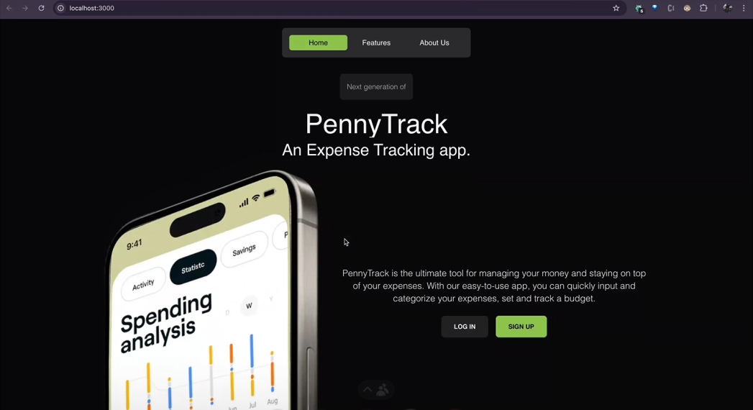
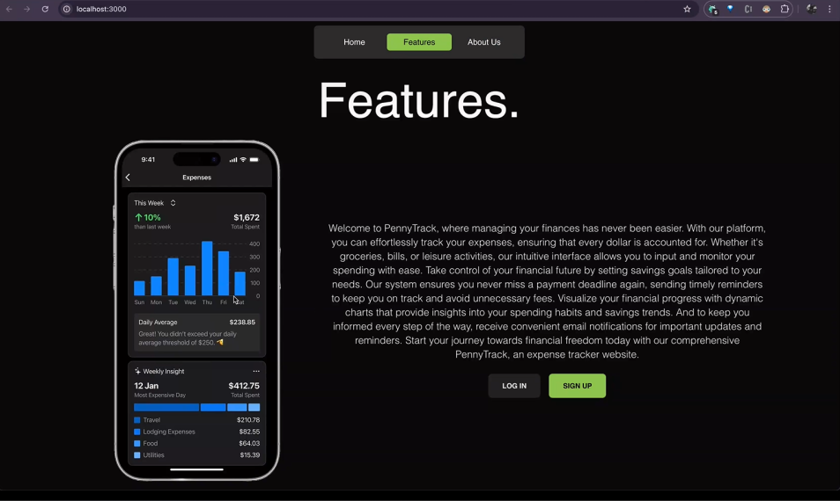
Methodology/Modules
Landing Module
Provides an intuitive introduction to PennyTrack, highlighting key features like expense tracking and AI-powered investment advice. It guides users to sign up or log in. The UI is designed for ease of navigation and user engagement.

Slide 16
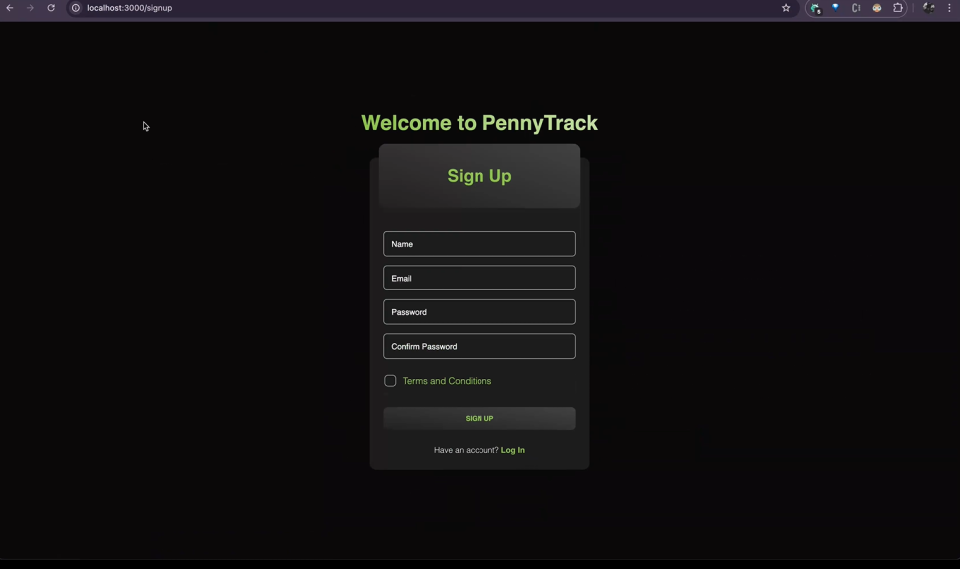
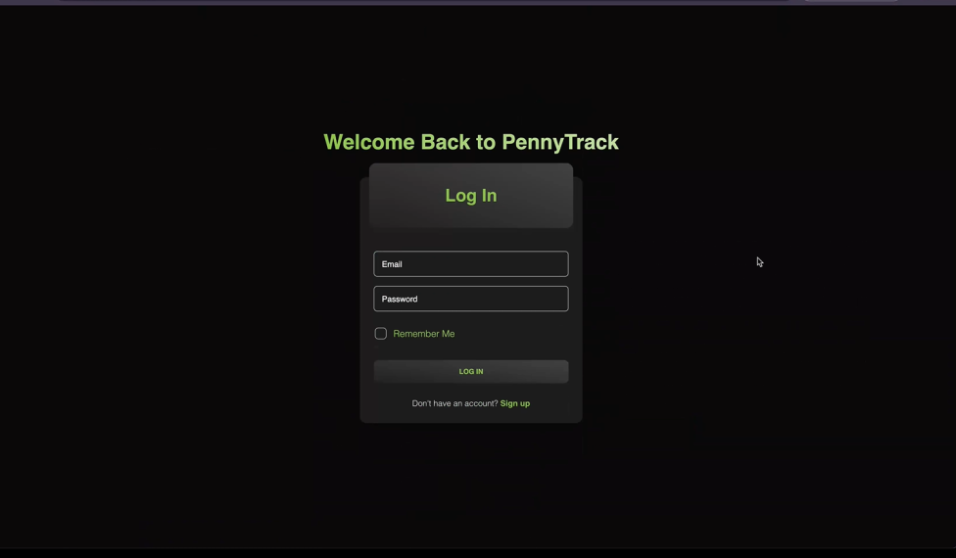
Methodology/Modules
Authentication – Sign Up and Login
Manages secure user registration, login, and session management using encrypted credentials. Implements role-based access to differentiate between user and admin functionalities. Integrates with JWT for secure token-based authentication.

Slide 17
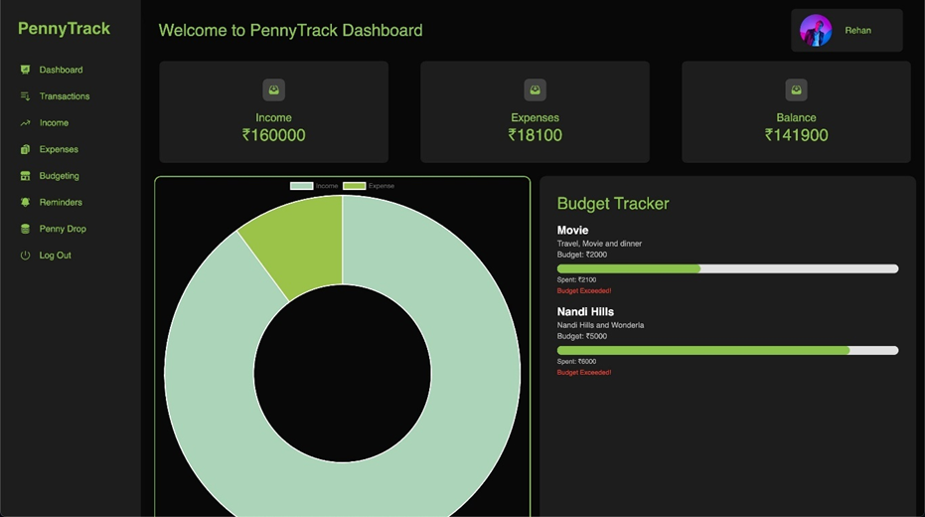
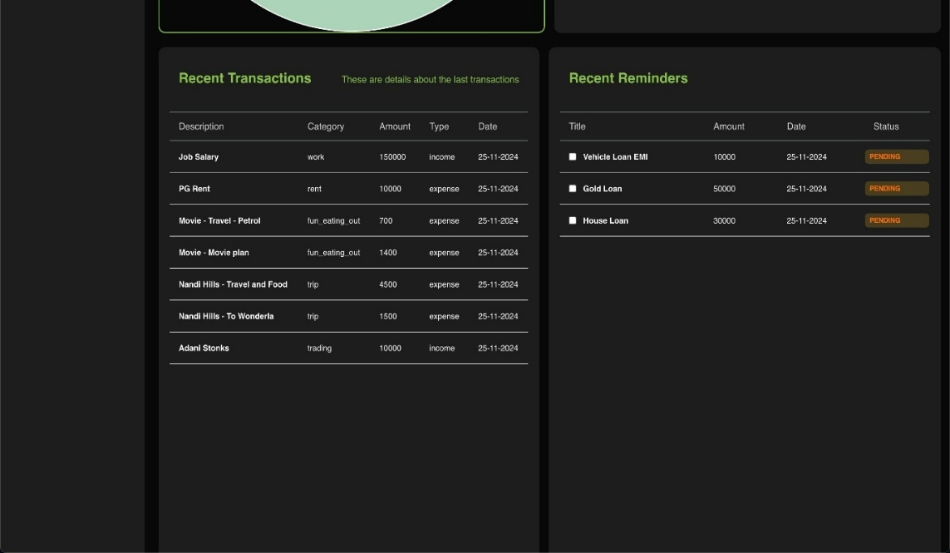
Methodology/Modules
User Dashboard Module
Displays an overview of income, expenses, budgeting, and personalized investment suggestions. Offers interactive charts and summaries for better financial insights. Acts as a central hub for user interactions and navigation across modules.

Slide 18
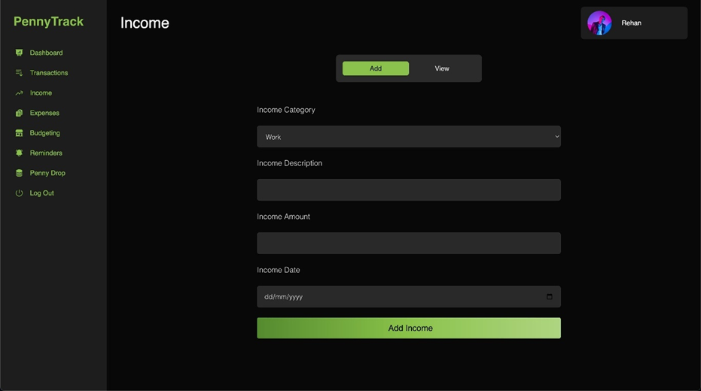
Methodology/Modules
Income Module
Allows users to input and categorize various income sources. Tracks income trends over time for better financial planning. This data feeds into the AI model for tailored investment recommendations.

Slide 19

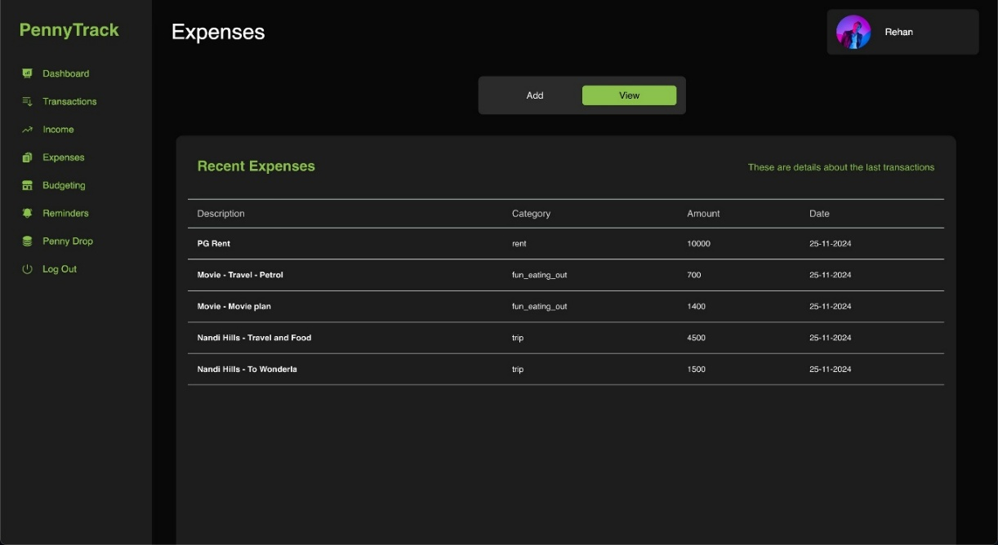
Methodology/Modules
Expense Module
Enables users to log and categorize daily expenses. Provides visual breakdowns to identify spending habits. The data collected supports budgeting and personalized financial insights.

Slide 20
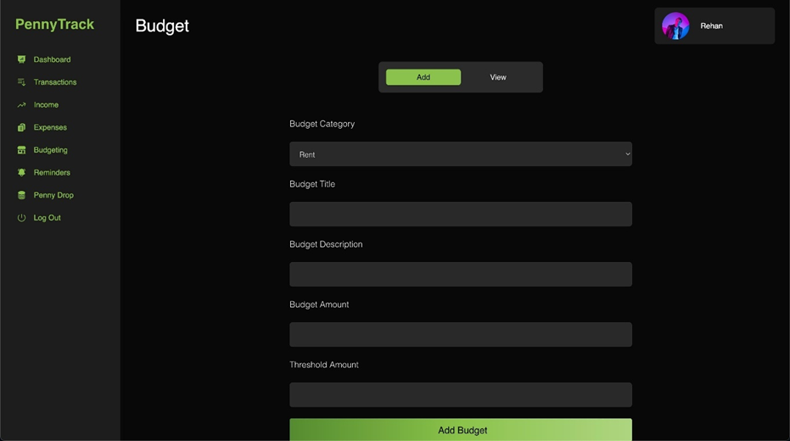
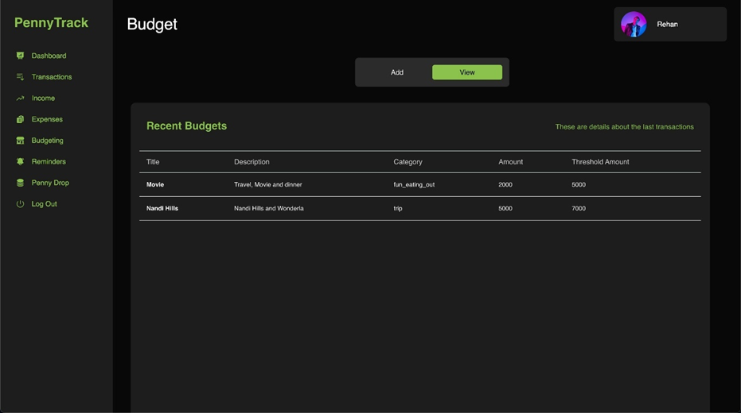
Methodology/Modules
Budget Module
Helps users set monthly/annual budgets across different categories. Provides alerts when users approach or exceed budget limits through our Budget Tracker. Integrates with income and expense data to maintain financial balance.

Slide 21


Methodology/Modules
Budget Tracker
Budget Tracker a React-based tool that aids in monitoring and managing budgets effectively.
It calculates spending metrics and tracks progress using the following formula:
Where:
Spent Amount is calculated as:
𝑇𝑐 : Transactions in category c
𝑡, amount: Transaction amount
Threshold Amount is the maximum permissible spending before triggering a warning.

Slide 22
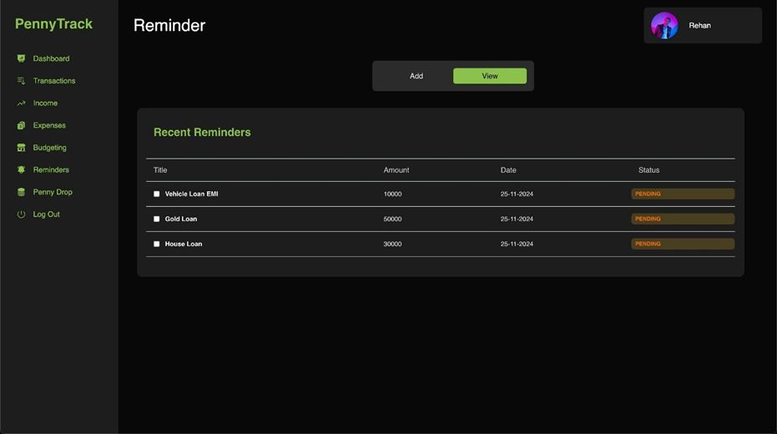
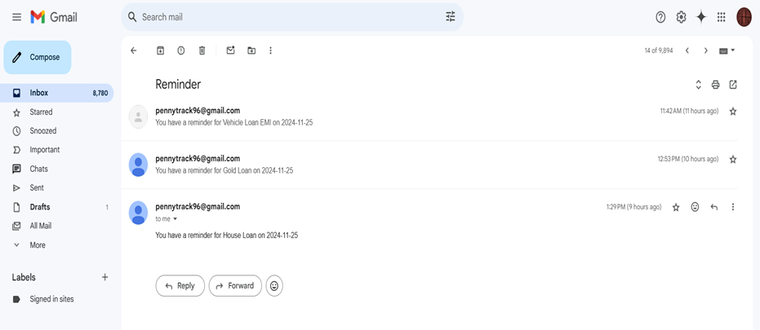
Methodology/Modules
Reminder Module
To improve user engagement and adherence to financial goals, the system includes a notification feature that provides timely reminders for key financial tasks. These reminders ensure users stay on track with their budgets and investment objectives, optimizing financial management.

Slide 23
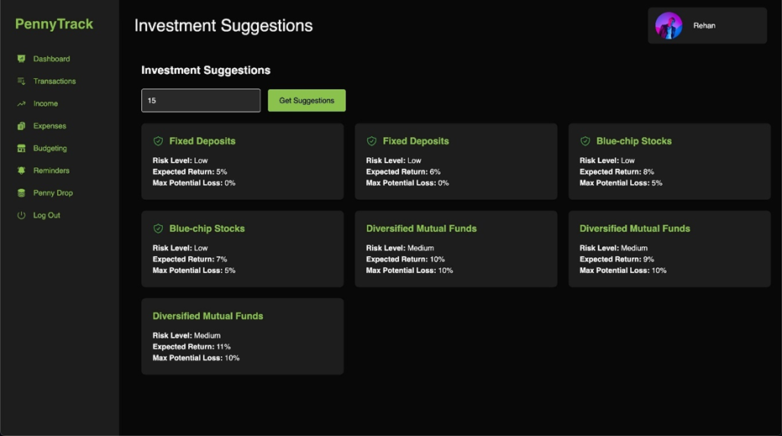

Methodology/Modules
Investment Module
The formula for the Gini Index is:
Where:
𝑝 is the proportion of class 𝑖 in subset S
W
Utilizes a CART(Classification and Regression Tree) model through our PennyDrop based on Gini-index evaluation, to offer AI-driven investment suggestions based on the user's income and spending patterns. Recommends suitable investment plans to achieve financial goals. Continuously adapts recommendations as financial data changes.

Slide 24
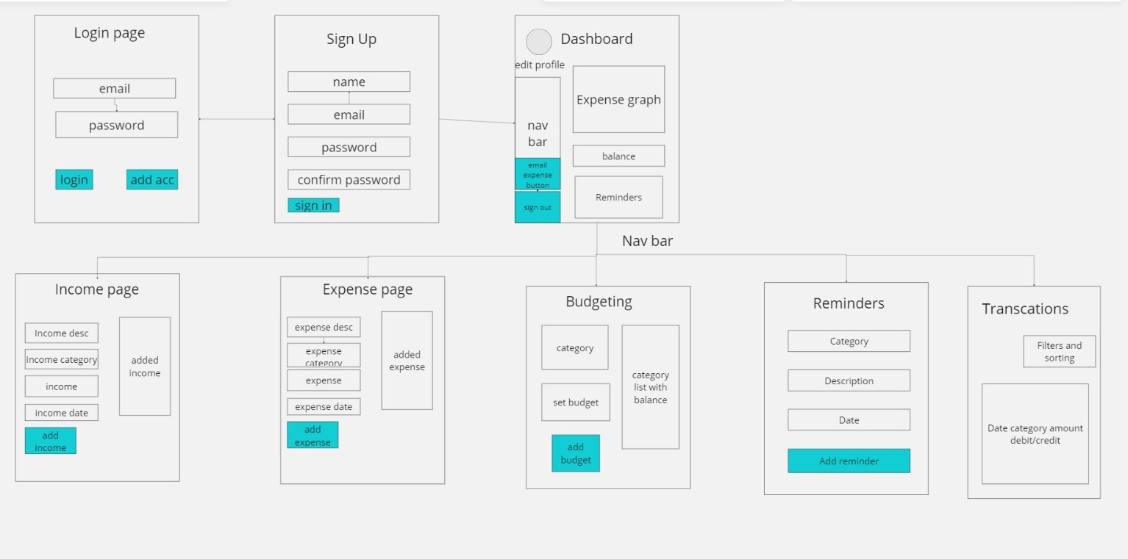
Architecture
PennyTrack Architecture
The PennyTrack module facilitates efficient expense management by providing a dashboard for income, expenses, budgeting, reminders, and transactions.
This data is then categorized and analyzed to generate visual insights through interactive charts. The architecture emphasizes ease of use, enabling users to monitor their financial activities in real time.

Slide 25
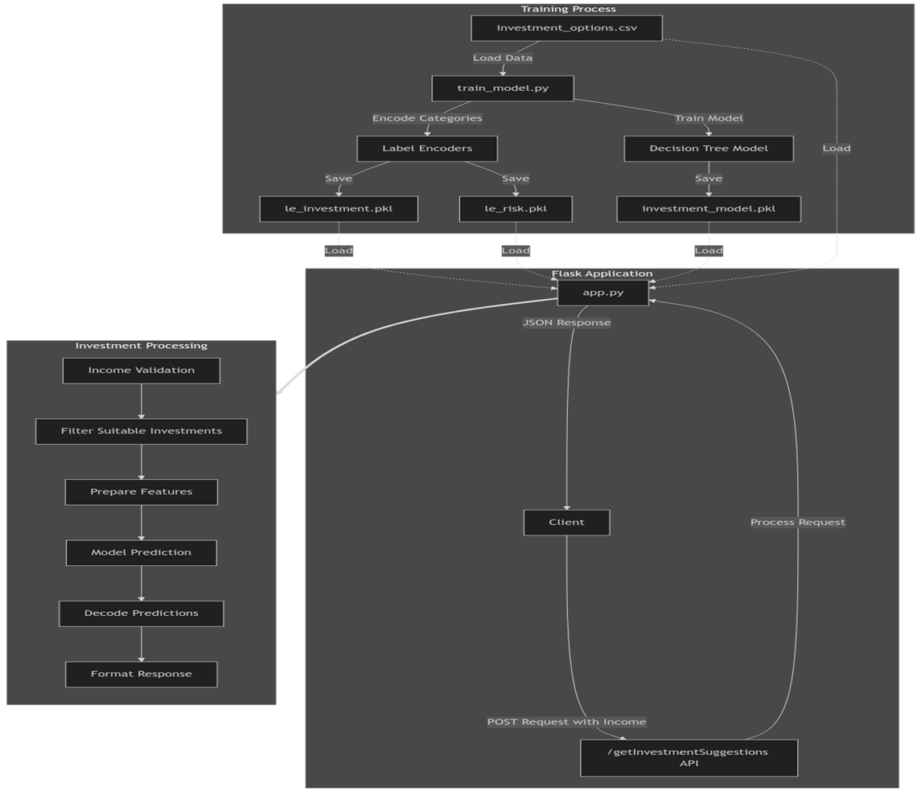
Architecture
PennyDrop Architecture
The PennyDrop module utilizes a CART model for personalized investment recommendations based on user income and expenses.
Training Process: Preprocesses data and trains a Decision Tree Classifier to categorize investment types and risk levels.
Request Processing: The Flask backend validates user input, processes features, and generates predictions using the trained model.
Client Interaction: Delivers personalized investment suggestions to users through structured JSON responses.

Slide 26
Hardware/Software components
Software Requirements
Backend (Node.js, Express, MongoDB)
Operating System: Windows, macOS, or Linux
Node.js: v12.x or higher
MongoDB: Local or cloud-based (e.g., MongoDB Atlas)
npm (Node Package Manager): v6.x or higher
Frontend (NextJS,ReactJS)
Node.js: v12.x or higher
npm or yarn: For managing dependencies
Browser: Modern browsers (Chrome, Firefox, Edge)
Development Tools
Code Editor: Visual Studio Code (recommended)
Version Control: Git for source control (GitHub or similar)

Slide 27
Hardware/Software components
Hardware Requirements
For Local Development
Processor: Intel Core i5 (minimum)
RAM: 8 GB RAM (minimum)
Storage: 10 GB free space
Network: Stable internet connection for development and API testing
For Hosting/Production
Processor: Dual-core processor (minimum)
RAM: 2 GB (minimum)
Storage: 10 GB
Deployment/Hosted Services
MongoDB Atlas: Cloud-hosted MongoDB service, reducing the need for local DB
Docker, Kubernetes: Containerization and Orchestration of Docker images.
AWS, or DigitalOcean: For hosting the MERN application in the cloud

Slide 28
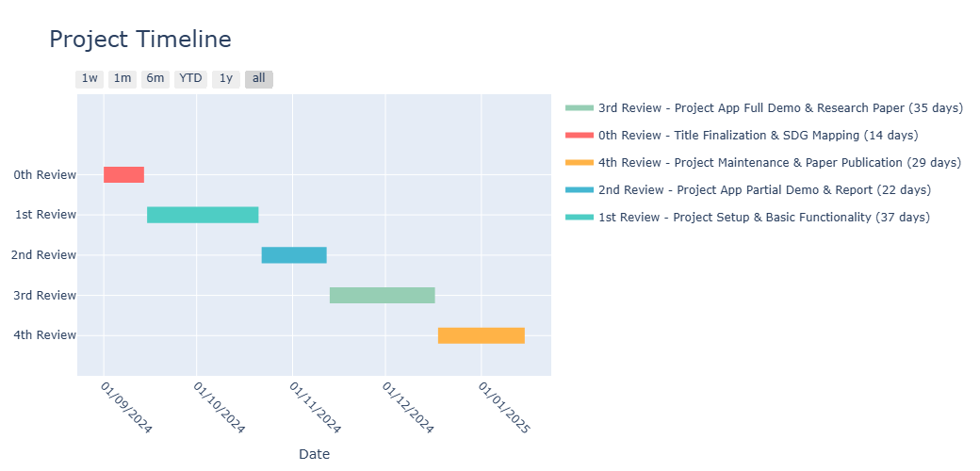
Project Timeline
Timeline & Gantt Chart
The PennyTrack project began on 14th September 2024 with planning, finalizing the title, and aligning it with SDGs. By 21st October 2024, the core system was developed, integrating backend and frontend functionalities. A partial demo showcasing expense tracking and data visualization was presented on 12th November 2024. The fully developed app with AI-driven investment features and the final research paper were completed by 17th December 2024. The project concluded on 15th January 2025 with system maintenance, issue resolution, and research paper submission for publication.

Slide 29
Expected Outcomes
Enhanced Financial Awareness: Users gain insights into their spending habits, improving financial decision-making.
Simplified Expense Tracking: Automated tracking reduces the need for manual entry in diaries or spreadsheets.
Consistent Budget Management: Daily allowances are adjusted based on spending patterns to maintain a balanced budget.
Improved Financial Stability: Informed financial choices help users avoid budget crises and foster long-term stability.
Better Organizational Financial Control: Organizations benefit from systematic budgeting and expense management tools for better oversight.
User Satisfaction through Intuitive Design: A user-friendly interface ensures ease of use and encourages regular engagement.
Increased Savings: Automated savings tracking redirects unspent daily allowances into savings, promoting financial growth.

Slide 30
Conclusion
The Expense Tracker project revolutionizes personal and organizational financial management by offering a user-friendly, cloud-based solution that simplifies expense tracking. By automating the process, users can effortlessly monitor their income, expenses, and savings while gaining valuable insights into their spending habits.
The application's predictive capabilities, customizable reports, and real-time financial feedback empower users to make informed decisions and maintain financial stability.
For organizations, it streamlines budgeting and cost management, providing a clearer path to financial optimization. With its intuitive interface, scalability, and reliance on advanced technology, the Expense Tracker not only promotes responsible spending but also enhances financial literacy, making personal finance management accessible and engaging in the digital age.

Slide 31
Github Link
The Github link provided should have public access permission.
Github Link
https://github.com/Neverm1ndEZ/captsone-project

Slide 32
References
[1] J. Han, M. Kamber, and J. Pei, Data Mining: Concepts and Techniques (3rd Edition), Morgan Kaufmann Publishers, 2012, ISBN: 978-0-12- 381479-1.
[2] R. Pressman, Software Engineering: A Practitioner’s Approach (5th Edition), McGraw-Hill, 2001.
[3] Dr. V. Geetha, G. Nikhitha, H. Sri Lasya, and Dr. C.K. Gomathy, “Expenditure Management System,” IEEE, May 16, 2022.
[4] Aman Garg, Mukul Goel, Sagar Mittal, and Mr. Shekhar Singh, “Expense Tracker,” International Journal for Research in Applied Science & Engineering Technology (IJRASET), Vol. 9, Issue IV, April 2021, pp. 1067–1070.
[5] “Online Income and Expense Tracker,” International Research Journal of Engineering and Technology (IRJET), Vol. 6, Issue 3, 2019, e-ISSN: 2395-0056, p-ISSN: 2395-0072.
[6] A. Sharma et al., “Personal Finance Management Using Machine Learning,” 2020. This paper explores machine learning algorithms for categorizing expenses and providing insights into spending patterns.

Slide 33
Thank You

